Slide 1
ECMAScript 6
Ahmed Elashry
aelashry@outlook.com

Slide 2
ECMAScript History

Slide 3
Language Features
string
BLOCK SCOPING
Function
Destructuring assignment
Array
Object
Class
Promise

Slide 4
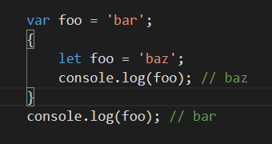
Let and Block Scope
The block scope restricts a variable’s access to the block in which it is declared. The var keyword assigns a function scope to the variable. Unlike the var keyword, the let keyword allows the script to restrict access to the variable to the nearest enclosing block.
Notes:
function test() {
var num = 100
console.log("value of num in test() "+num)
{
console.log("Inner Block begins")
let num = 200
console.log("value of num : "+num)
}
}
test()
//===================== let no = 10;
let no = 20;
console.log(no);
//====================
function letTest() {
let x = 1;
if (true) {
let x = 2; // different variable
console.log(x); // 2
}
console.log(x); // 1
}

Slide 5
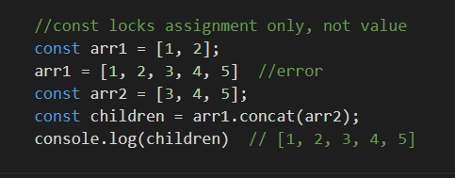
The const
This declaration creates a constant whose scope can be either global or local to the block in which it is declared. An initializer for a constant is required; that is, you must specify its value in the same statement in which it's declared (which makes sense, given that it can't be changed later).Constants cannot be reassigned a value.
A constant cannot be re-declared.
The value assigned to a const variable is immutable.
Notes:
const x = 10
x = 12 // will result in an error!!
// const also works on objects
const MY_OBJECT = {'key': 'value'};
// Attempting to overwrite the object throws an error - Uncaught TypeError: Assignment to constant variable.
//MY_OBJECT = {'OTHER_KEY': 'value'}; // However, object keys are not protected,
// so the following statement is executed without problem
MY_OBJECT.value = 'otherValue';
console.log(MY_OBJECT)
MY_OBJECT.dd="hi"

Slide 6
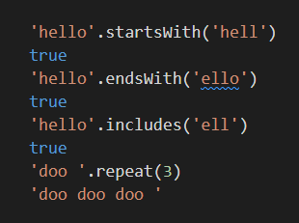
New string methods:
Notes:
'hello'.startsWith('hell')
true
'hello'.endsWith('ello')
true
'hello'.includes('ell')
true
'doo '.repeat(3)
'doo doo doo '

Slide 7
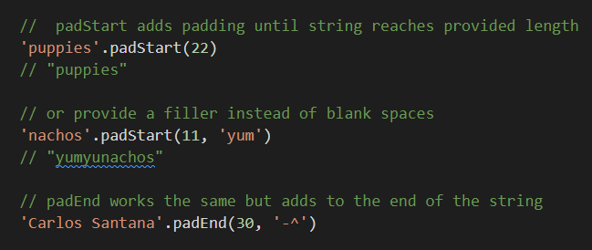
New string methods:
Notes:
// padStart adds padding until string reaches provided length
console.log('puppies'.padStart(22))
// "puppies"
// or provide a filler instead of blank spaces
console.log('nachos'.padStart(11, 'yum'))
// "yumyunachos"
// padEnd works the same but adds to the end of the string
console.log('Carlos Santana'.padEnd(30, '-^'))

Slide 8
Multi-line template literals
Template literals are enclosed by the back-tick (` `) (grave accent) character instead of double or single quotes. Template literals can contain place holders. These are indicated by the Dollar sign and curly braces (${expression}).
Notes:
console.log('string text line 1\n\
string text line 2');
// "string text line 1
// string text line 2“
console.log(`string text line 1
string text line 2`);
// "string text line 1
// string text line 2“
//Embedded expressions================================
var name = "Brendan";
console.log('Hello, ${name}!');
var a = 10;
var b = 10;
console.log(`The sum of ${a} and ${b} is ${a+b} `);
//Template literals and function expression
function fn() { return "Hello World"; }
console.log(`Message: ${fn()} !!`);

Slide 9
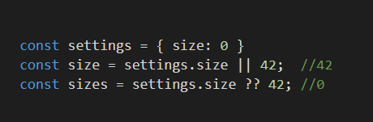
nullish operator
Using the || operator is very common to assign a default value when the one you are attempting to assign is null or undefined "" or false .
Notes:
const settings = { size: 0 }
//const setting = {}// { size: false };
const size = settings.size || 42; //42
const sizes = settings.size ?? 42; //0
console.log(size);
console.log(sizes);

Slide 10
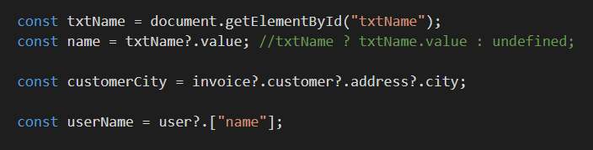
Optional chaining
The optional chaining operator (?.) allows you to have a more compact and readable code,
Notes:
const txtName = document.getElementById("txtName");
const name = txtName?.value; //txtName ? txtName.value : undefined;
console.log(name)
const invoice = {}
const customerCity = invoice?.customer?.address?.city;
console.log(customerCity)
const user = {}
const userName = user?.["name"];
console.log(userName)

Slide 11
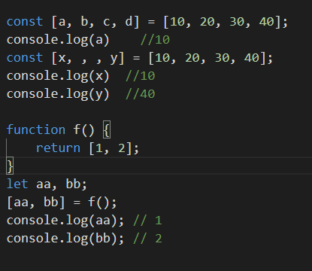
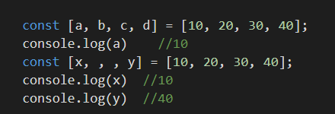
Destructuring assignment
The destructuring assignment syntax is a JavaScript expression that makes it possible to unpack values from arrays, or properties from objects, into distinct variables.
Notes:
const [a, b, c, d] = [10, 20, 30, 40];
console.log(a) //10
const [x, , , y] = [10, 20, 30, 40];
console.log(x) //10
console.log(y) //40
///////////////////////////////
function f() {
return [1, 2];
}
let aa, bb;
[aa, bb] = f();
console.log(aa); // 1
console.log(bb); // 2
////////////////////////////////////////
const { id, isVerified } = user;
console.log(id); // 42
console.log(isVerified); // true

Slide 12
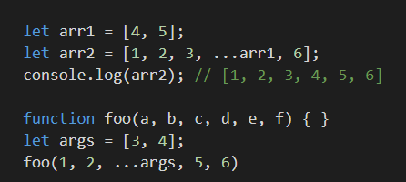
SPREAD OPERATOR
Notes:
let arr1 = [4, 5];
let arr2 = [1, 2, 3, ...arr1, 6];
console.log(arr2); // [1, 2, 3, 4, 5, 6]
function foo(a, b, c, d, e, f) { }
let args = [3, 4];
foo(1, 2, ...args, 5, 6)

Slide 13
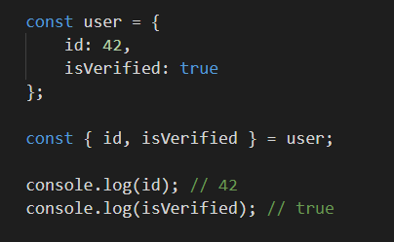
Object destructuring
Notes:
const user = {
id: 42,
isVerified: true
};
const { id, isVerified } = user;
console.log(id); // 42
console.log(isVerified); // true
//------------------------------------------------
const obj = {
sname: 'ahmed', age: 50,
address: { city: "cairo" },
xx: [30, 40],
yy: { xxx: "ffff", yyyy: "dddddd" }
}
const { sname: newName //=const newName = obj.sname
, age,
address: { city },//const city=obj.address.city
xx: [x, y] //const x=obj.xx[0]
} = obj;
console.log(newName, age, city, x, y)

Slide 14
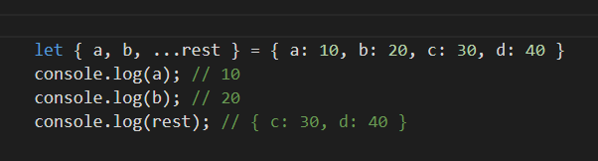
Rest in Object Destructuring
Notes:
let { a, b, ...rest } = { a: 10, b: 20, c: 30, d: 40 }
console.log(a); // 10
console.log(b); // 20
console.log(rest); // { c: 30, d: 40 }

Slide 15
for...in statement
The for...in statement iterates a specified variable over all the enumerable properties of an object. For each distinct property, JavaScript executes the specified statements.
Notes:
var obj = {a: 1, b: 2, c: 3};
for (const prop in obj) {
console.log(`obj.${prop} = ${obj[prop]} `);
}

Slide 16
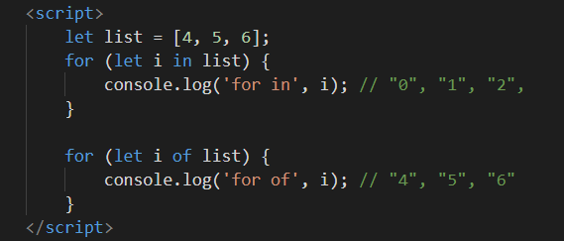
For in Vs For of
for..in iterates over all enumerable property keys of an object
for..of iterates over the values of an iterable object. Examples of iterable objects are arrays, strings, and NodeLists.

Slide 17
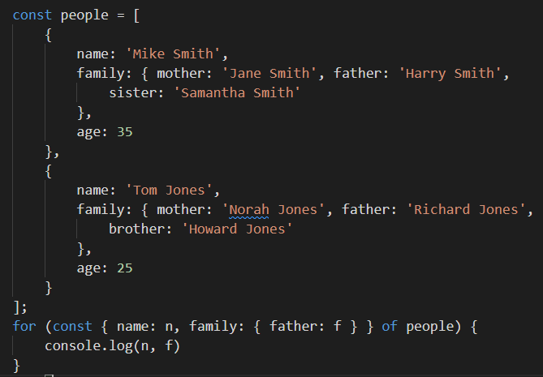
For of iteration and destructuring
Notes:
const people = [
{
name: 'Mike Smith',
family: {
mother: 'Jane Smith',
father: 'Harry Smith',
sister: 'Samantha Smith'
},
age: 35
},
{
name: 'Tom Jones',
family: {
mother: 'Norah Jones',
father: 'Richard Jones',
brother: 'Howard Jones'
},
age: 25
}
];
for (const {name: n, family: {father: f}} of people) {
console.log('Name: ' + n + ', Father: ' + f);
}
// "Name: Mike Smith, Father: Harry Smith"
// "Name: Tom Jones, Father: Richard Jones"

Slide 18
Enumerate the properties of an object
Object.keys(o) This method returns an array with all the own (not in the prototype chain) enumerable properties' names ("keys") of an object o.
Object.getOwnPropertyNames(o) This method returns an array containing all own properties' names (enumerable or not) of an object o.
Notes:
// for in loops
var obj = {a: 1, b: 2, c: 3};
for (const prop in obj) {
console.log(`obj.${prop} = ${obj[prop]}`);
}
//object keys
var obj = { 0: 'a', 1: 'b', 2: 'c' };
console.log(Object.keys(obj)); // console: ['0', '1', '2']
//Object.getOwnPropertyNames
var obj = { 0: 'a', 1: 'b', 2: 'c' };
console.log(Object.getOwnPropertyNames(obj).sort());
// logs ["0", "1", "2"]
// Logging property names and values using Array.forEach
Object.getOwnPropertyNames(obj).forEach(
function (val, idx, array) {
console.log(val + ' -> ' + obj[val]);
}
);

Slide 19
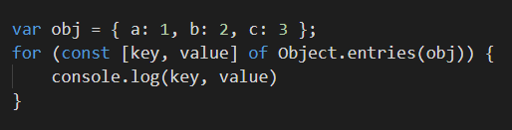
Object.entries
The Object.entries() method returns an array of a given object's own enumerable string-keyed property [key, value] pairs.
Notes:
const object1 = { a: 'somestring', b: 42};
for (const [key, value] of Object.entries(object1)) {
console.log(`${key}: ${value}`);
}

Slide 20
Array Methods
find() method returns the value of the first element in the provided. If no values satisfy the testing function, undefined is returned.
findIndex() returns the index of the first element in the. Otherwise, it returns -1, indicating that no element passed the test.
filter() Creates a new array with all of the elements of this array for which the provided filtering function returns true.
forEach() Calls a function for each element in the array.
map() creates a new array populated with the results of calling a provided function on every element in the calling array.

Slide 21
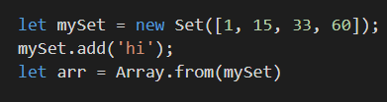
Set
Set objects are collections of values. You can iterate its elements in insertion order. A value in a Set may only occur once; it is unique in the Set's collection.
Set constructor accepts to convert to Array in the other direction .
Notes:
var mySet = new Set();
mySet.add(1);
mySet.add('some text');
mySet.add('foo');
mySet.has(1); // true
mySet.delete('foo');
mySet.size; // 2
for (let item of mySet) console.log(item);
// 1
// "some text“
//convert to array
var mySet2= Array.from(mySet);
console.log(mySet2);
//convert to set
mySet2 = new Set([1, 2, 3, 4]);
console.log(mySet2);

Slide 22
Array and Set compared
Checking whether an element exists in a collection using indexOf for arrays is slow.
Set objects let you delete elements by their value. With an array you would have to splice based on an element's index.
The value NaN cannot be found with indexOf in an array.
Set objects store unique values; you don't have to keep track of duplicates by yourself.

Slide 23
Functions
Functions are one of the fundamental building blocks in JavaScript. A function is a JavaScript procedure—a set of statements that performs a task or calculates a value. To use a function, you must define it somewhere in the scope from which you wish to call it.

Slide 24
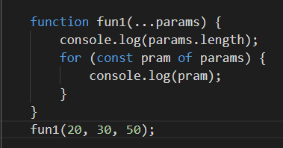
Function parameters
function allows the parameters to be initialized with default values
Rest parameters doesn’t restrict the number of values that you can pass to a function.
Notes:
function add(a, b = 1) { return a+b; } console.log(add(4))
//====================================
function fun1(...params) {
console.log(params.length);
}
fun1();
fun1(5);
fun1(5, 6, 7);

Slide 25

Lambda Functions(Arrow functions)
Lambda refers to anonymous functions in programming. Lambda functions are a concise mechanism to represent anonymous functions. These functions are also called as Arrow functions.
There are 3 parts to a Lambda function −
Parameters − A function may optionally have parameters.
The fat arrow notation/lambda notation (=>): It is also called as the goes to operator.
Statements − Represents the function’s instruction set.
Notes:
var foo = (x)=>10+x
console.log(foo(10))
//=========================
var msg = ()=> {
console.log("function invoked")
}
msg()
//=========================
var disp = ()=>console.log("Hello World")
disp();

Slide 26
Generator Functions
When a normal function is invoked, the control rests with the function called until it returns. With generators in ES6, the caller function can now control the execution of a called function. A generator is like a regular function
Notes:
function * generatorForLoop(num) {
for (let i = 0; i < num; i += 1) {
yield console.log(i);
}
}
const genForLoop = generatorForLoop(5);
genForLoop.next(); // first console.log - 0
genForLoop.next(); // 1
genForLoop.next(); // 2
genForLoop.next(); // 3
genForLoop.next(); // 4
//=========================
function * withYield(a) {
let b = 5;
yield a + b;
b = 6; // it will be re-assigned after first execution
yield a * b;
}
const calcSix = withYield(6);
calcSix.next().value; // 11
calcSix.next().value; // 36
for (const iterator of calcSix) {
console.log (iterator)
}
//=================================
function * generator() {
yield 1;
return 2;
yield 3; // we will never reach this yield
}
const gen = generator();
gen.next(); // {value: 1, done: false}
gen.next(); // {value: 2, done: true}
gen.next(); // {value: undefined, done: true}

Slide 27
Objects
An object is an instance which contains a set of key value pairs. Unlike primitive data types, objects can represent multiple or complex values and can change over their life time. The values can be scalar values or functions or even array of other objects.
The contents of an object are called properties (or members), and properties consist of a name (or key) and value. Property names must be strings or symbols, and values can be any type (including other objects).
Unassigned properties of an object are undefined (and not null).
Notes:
//Object Initializers
var person = {
firstname:"Tom",
lastname:"Hanks",
func:function(){return "Hello!!"},
};
//access the object values
console.log(person.firstname)
console.log(person.lastname)
console.log(person.func())
//one line
var myObj = new Object(),
str = 'myString',
rand = Math.random(),
obj = new Object();
var myHonda = {color: 'red', wheels: 4, engine: {cylinders: 4, size: 2.2}};

Slide 28
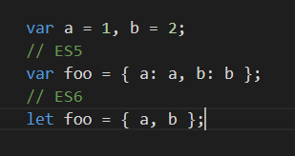
Object Property shorthand
Notes:
var a = 1, b = 2;
// ES5
var foo = { a: a, b: b };
// ES6
let foo = { a, b };

Slide 29
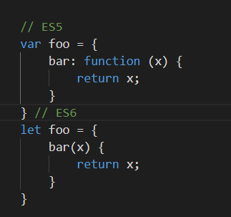
Object Compact method syntax
Notes:
// ES5
var foo = {
bar: function (x) {
return x;
}
} // ES6
let foo = {
bar(x) {
return x;
}
}

Slide 30
Object.freeze() Function
The Object.freeze() method freezes an object. A frozen object can no longer be changed; freezing an object prevents new properties from being added to it, existing properties from being removed, prevents changing the enumerability, configurability, or writability of existing properties, and prevents the values of existing properties from being changed
Notes:
const obj = { prop: 42};
Object.freeze(obj);
obj.prop = 33;// Throws an error in strict mode
console.log(obj.prop);// expected output: 42

Slide 31
Object.seal() Function
The Object.seal() method seals an object, preventing new properties from being added to it Values of present properties can still be changed as long as they are writable.
Notes:
const object1 = { property1: 42};
Object.seal(object1);
object1.property1 = 33;
console.log(object1.property1);// expected output: 33
delete object1.property1; // cannot delete when sealed
console.log(object1.property1);// expected output: 33

Slide 32
Object.defineProperty()
Configurable true if the property may be deleted from the corresponding object. Defaults to false.
Enumerable true if and only if this property shows up during enumeration of the properties on the corresponding object. Defaults to false.
Value Can be any valid JavaScript value (number, object, function, etc). Defaults to undefined.
Writable true if the value associated with the property may be changed with an assignment operator. Defaults to false.
Notes:
var obj = {};
Object.defineProperty(obj, 'key', { enumerable: false, configurable: false, writable: false, value: 'static' });

Slide 33
Object.defineProperty()
Get The return value will be used as the value of the property. Defaults to undefined.
Set with this set to the object through which the property is assigned. Defaults to undefined.
Notes:
var bValue = 38;
Object.defineProperty(o, 'b', {
// This is equivalent to:
// get: function() { return bValue; },
// set: function(newValue) { bValue = newValue; },
get() { return bValue; },
set(newValue) { bValue = newValue; },
enumerable: true,
configurable: true
});
o.b; // 38

Slide 34
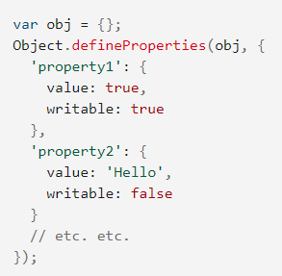
Object.defineProperties()
The Object.defineProperties() method defines new or modifies existing properties directly on an object, returning the object.

Slide 35
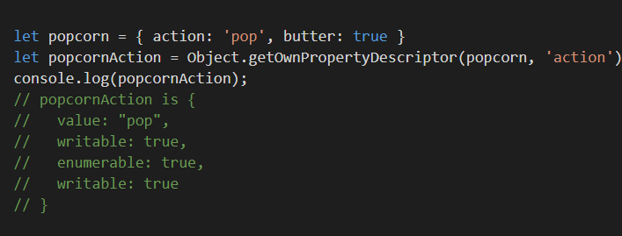
Object.getOwnPropertyDescriptor
Notes:
let popcorn = { action: 'pop', butter: true }
let popcornAction = Object.getOwnPropertyDescriptor(popcorn, 'action')
console.log(popcornAction);
// popcornAction is {
// value: "pop",
// writable: true,
// enumerable: true,
// writable: true
// }

Slide 36
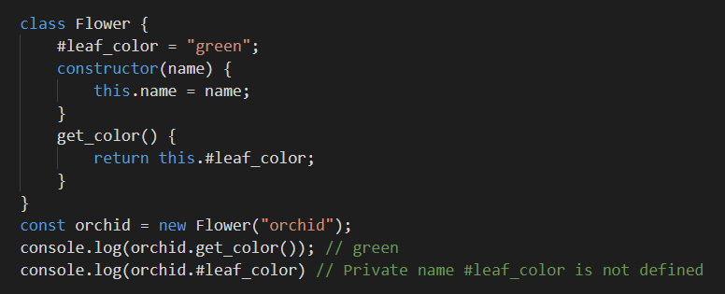
Class Private Fields
JavaScript supports class syntax since ES6, but only now were private fields introduced. To define a private property, it has to be prefixed with the hash symbol: #.
Notes:
class Flower {
#leaf_color = "green";
constructor(name) {
this.name = name;
}
get_color() {
return this.#leaf_color;
}
}
const orchid = new Flower("orchid");
console.log(orchid.get_color()); // green
console.log(orchid.#leaf_color) // Private name #leaf_color is not defined

Slide 37
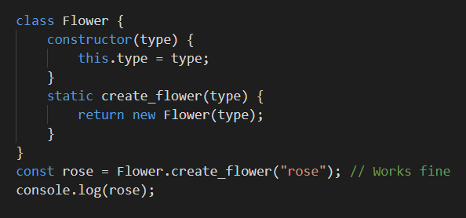
Static Fields
a class method can now be declared with the static keyword and called from outside of a class.
Notes:
class Flower {
constructor(type) {
this.type = type;
}
static create_flower(type) {
return new Flower(type);
}
}
const rose = Flower.create_flower("rose"); // Works fine
console.log(rose);

Slide 38
Promise
Promise for a value to be returned in a future
Can have three mutually exclusive states
fulfilled
rejected
pending
Can be referred as deferred or future
Powerful for asynchronous / concurrent applications
Notes:
function getProducts(){
return new Promise((resolve,reject)=>{
var xhr = new XMLHttpRequest();
xhr.open("get","https://fakestoreapi.com/products",true);
xhr.onreadystatechange = function(){
if(xhr.readyState == 4){
if(xhr.status == 200){
resolve(JSON.parse(xhr.responseText)); //then
}
else{
reject("something went wrong"); //catch
}
}
}
xhr.send();
})
}
getProducts()
.then((data)=>{
data.sort((a,b)=>{return b.price-a.price});
return data;
})//resolve
.then((data)=>{
var subData = data.slice(0,10);
return subData;
})
.then((data)=>{
var result = 0;
for(item of data)
result += item.price;
return result;
})
.then((data)=>{console.log(data)})
.catch((error)=>{console.log(error);})//reject

Slide 39
MODULES
It has therefore made sense in recent years to start thinking about providing mechanisms for splitting JavaScript programs up into separate modules that can be imported when needed.

Slide 40
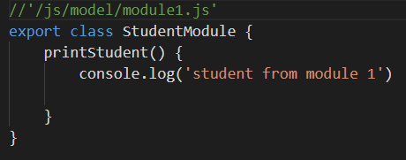
export
Notes:
//'/js/model/module1.js'
export class StudentModule {
printStudent() {
console.log('student from module 1')
}
}

Slide 41
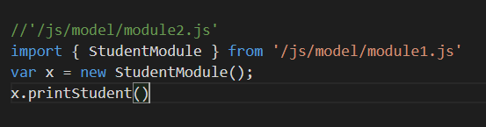
import
Notes:
/'/js/model/module2.js'
import { StudentModule } from '/js/model/module1.js'
var x = new StudentModule();
x.printStudent()

